Slide 1
Agile Estimating & Velocity
420-E31 Systems III
References:
Leffingwell – Agile Software Requirements
Rubin – Essential Scrum

Slide 2
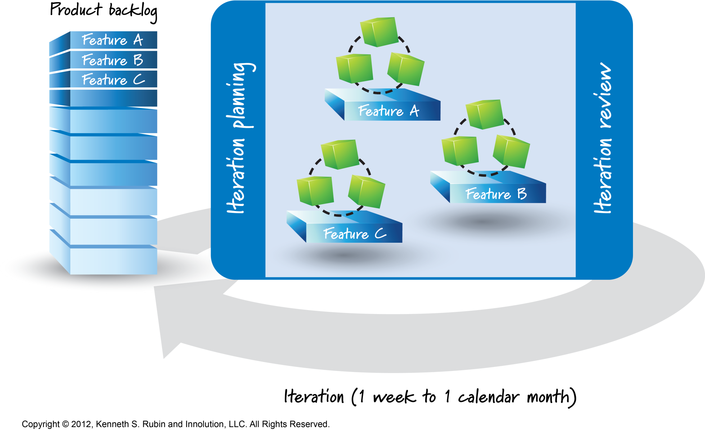
Agile Development Overview
Notes:
Recap and draw (with input/recollection from class):
product backlog (user stories) , iteration backlog relate to: Product plan, release plan, iteration plan

Slide 3

Agile Estimation
The traditional project estimating techniques that we looked at last week have a wide margin of error.
Solid estimating skills are critical to an agile team’s productivity and success.

Slide 4
Goal: More Reliable Estimates
Without reliable estimates, there is no way to predict how much value a team can deliver in a time period.
Agile breakthroughs:
Know where you are now – progress based on working code.
More accurately predict where you will be next – based on velocity of prior iterations.

Slide 5
Why Estimate?
Determine cost – estimate effort, which enables estimating cost.
Establish priorities
Establish schedule and commitment
Estimating is the key to unlocking the ability to commit.

Slide 6
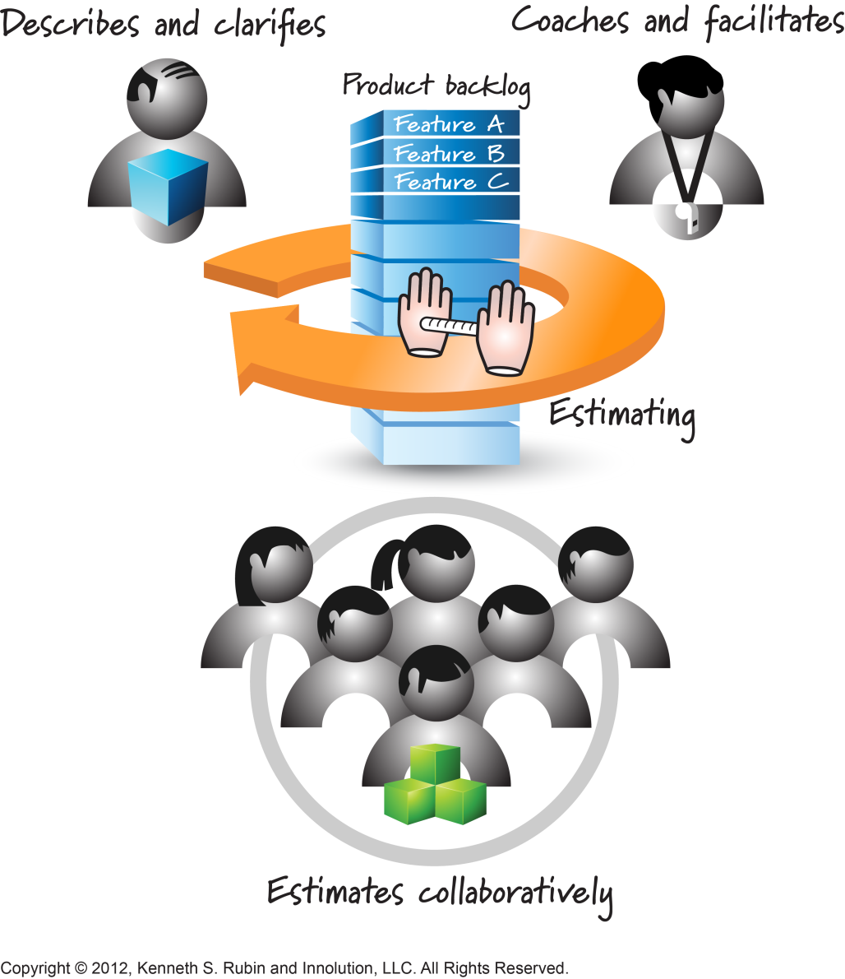
Who does Estimating?

Slide 7
Estimates Are Not Commitments
Expectation is to get a realistic measure of how big something is.
Don’t want them to be artificially inflated
How long will it take you to complete task A?
How long will it take you to complete task A if your yearly bonus is based on your estimated being correct?

Slide 8
Estimating with User Story Points
Uses user stories as the item to estimate
Estimates the size of a user story compared to other stories of a similar type.
Story points are unitless but numerically relevant.
A two point story should take twice as long as a one point story
Notes:
Stress “unitless”

Slide 9
Estimating with User Story Points
A story point is an integer number that represents an aggregation of:
Knowledge – do we understand what the story does?
Complexity – how hard is it to implement?
Volume – How much of it is there? How long is it likely to take?
Uncertainty – What isn’t known, and how might this affect the estimate.

Slide 10
Example
Assign “dog points” to each of the following types of dog to compare their “bigness”.
Labrador Retriever
Dachshund
Great Dane
Terrier
German Shephard
Poodle
St. Bernard
Bulldog
Notes:
What does bigness mean? Height, weight, mass, bite?
What kind of poodle? Standard? Toy?
What scale shoud we use?

Slide 11
Lessons Learned
There will always be ambiguity in the estimating process.
When in doubt, ask the product owner for clarification.

Slide 12
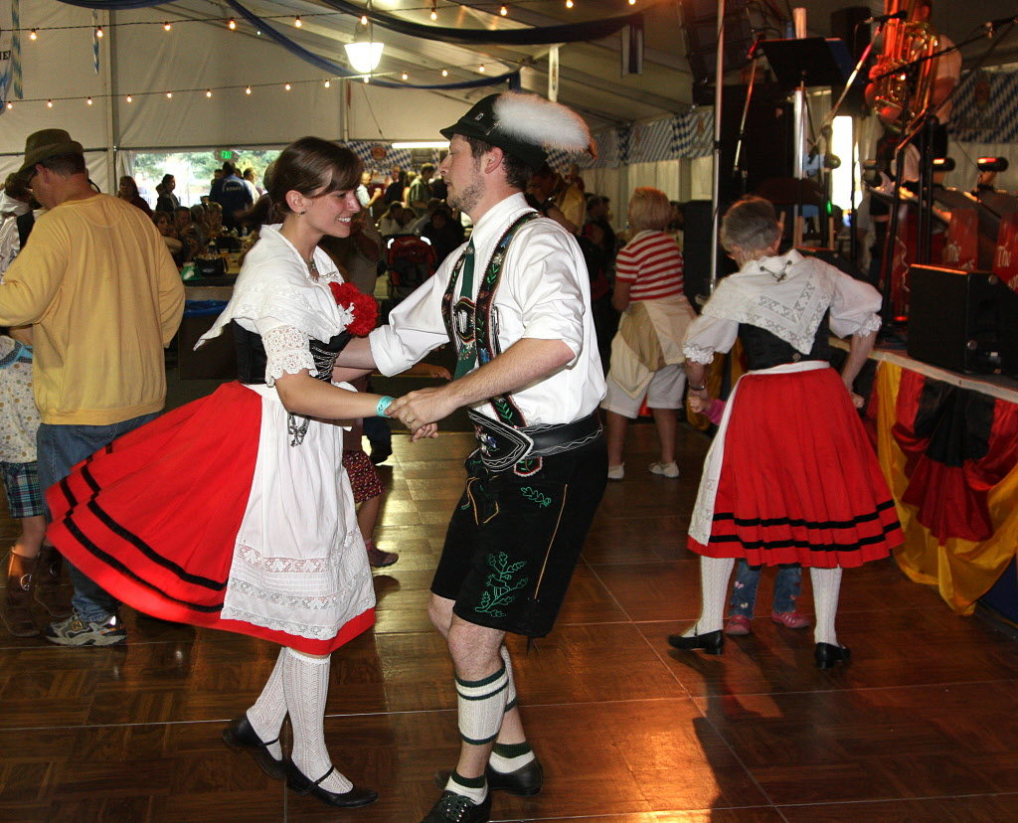
Today we “Polka”!
Notes:
Just kidding, I mean “Poker”!
Put away the lederhosen guys
For humour, checkout : https://www.youtube.com/watch?v=2LEAiGDw220

Slide 13
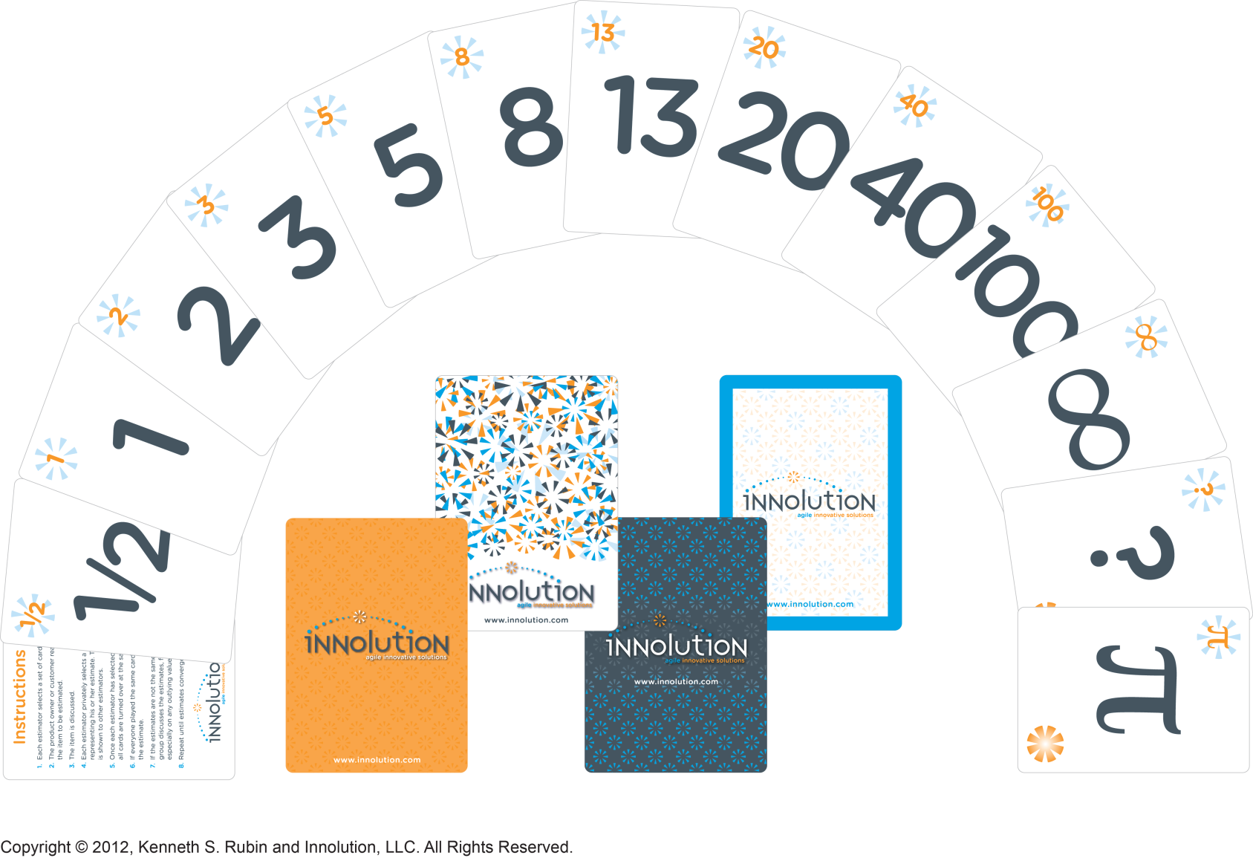
Planning Poker
Video: https://www.youtube.com/watch?v=0FbnCWWg_NY
Notes:
https://www.youtube.com/watch?v=0FbnCWWg_NY

Slide 14
Rules for Planning Poker
Participants include ALL agile team members
The product owner participates but does not estimate
Each estimator is given a deck of cards with numbers as their value
0, 1, 2, 3, 5, 8, 13, 20, 40, 100

Slide 15
Rules for Planning Poker
For each story, product owner reads description
Questions are asked/answered
Each estimator privately selects their card representing their own estimate
All cards are simultaneously turned over
High and low estimators explain
After discussion, each estimator re-estimates and the process repeats.
Notes:
If time permits in class: planning poker
Estimate:
Effort: how long would it take to knit a touque (unitless)
Effort: how long would it take to knit a 4 ft scarf (unitless)
Effort: Knit a sweater for Francis (unitless)
Effort: Knit a onesie for Mustafa. Must have a butt flap with buttons. (unitless)

Slide 16
Key Things about Planning Poker
Estimate comes from the team as a whole.
Group estimate rather than manager doing the estimate
A consensus must be achieved before a final estimate is reached.
By discussing the high/low estimates, teams discover assumptions
It happens quickly. 2 – 5 minutes of discussion per item.
Should be able to estimate 10 – 20 stories per hour

Slide 17
Key Things about Planning Poker
The number range is cleverly designed.
Lower range (0,1,2,3,5,8) is designed to help teams estimate small things precisely.
Higher range (20, 40, 100) indicate large items have greater uncertainty.
Story is too big and needs to be split
Zero gives the team a way to ignore small stories that can be implemented in just a few hours.
Notes:
Explain human inability to deal with concrete numbers but good at estimating relatively.
i.e. that building is twice as tall, but you might not be able to say how tall it is

Slide 18
Key Things About Planning Poker
∞ (infinity) is used to say the item is so large it doesn’t make sense to put a number on it
? means team member doesn’t understand the item and needs more info
π means “I’m tired and hungry and need a break”

Slide 19
Distributed Estimating with Planning Poker
When face-to-face estimation isn’t possible, there are online tools that support planning poker with distributed teams.
Teams log into a planning poker Web site and play the game from their own desktop.
www.planningpoker.com
A moderator (usually product owner) facilitates the session.

Slide 20
Tabletop Relative Estimation
An alternative to Planning Poker
Involves entire agile team, but requires face-to-face communication
Teams discuss each story and place the story on a table in a size position relative to the other stories.
Stories of the same size are put in columns
Stories are rearranged as the progress is made.
Points are assigned at the end to each column

Slide 21
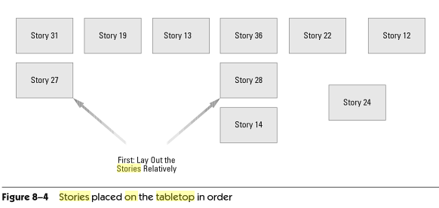
Tabletop Relative Estimation
Notes:
Source: Agile Software Requirements by Dean Leffingwell

Slide 22
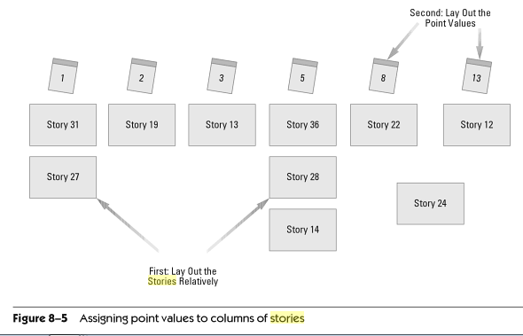
Tabletop Relative Estimation
Notes:
Source: Agile Software Requirements by Dean Leffingwell

Slide 23
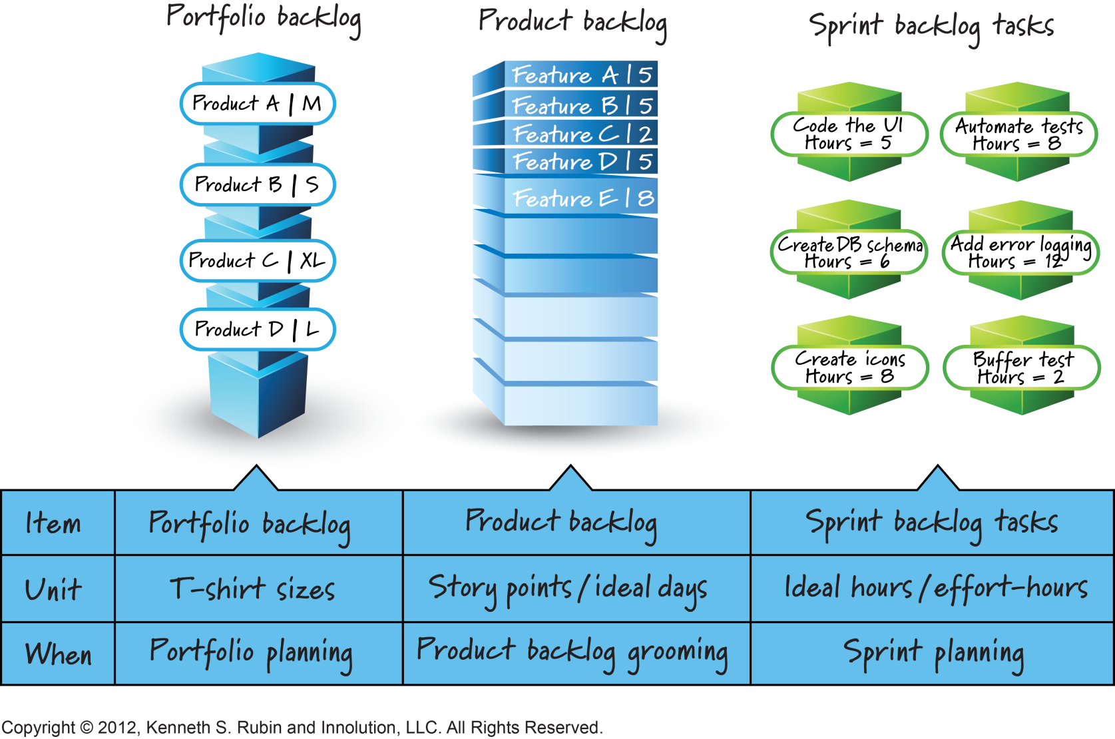
What/When to Estimate
Notes:
Portfolio
The portfolio level of a backlog typically houses epics, or very large stories that represent work to be done across multiple project teams toward a common goal. Often these epics represent cross-cutting work that serves multiple programs across a portfolio. They are reviewed frequently, prioritized and remain in the backlog awaiting scheduling and implementation at the program, release and then iteration levels.
Program
The program backlog represents the work from the portfolio backlog that has been approved for implementation by a project team. Moving items into the program backlog signifies that they are ready to be decomposed, estimated and scheduled in a near-term release.

Slide 24
Velocity
We’ve looked at how agile teams might estimate stories with story points, but this doesn’t tell us how long it will take, which is the other half of estimating.
To get the time component, we need to know the teams’ velocity.

Slide 25
Velocity
A team’s velocity is how many points that team can complete in a standard iteration.

Slide 26
Using Velocity to Predict
Given a team’s known historical velocity, they can now predict how long it will take them (how many iterations) to complete an arbitrary amount of work.

Slide 27
Caveats on using Velocity
It is based on historical data and is predictive only to the extent that the future stories look like the past stories.
It is valid only to the extent that the team has the same members. If you change team members, velocity will change.
A team’s velocity cannot be compared to any other team.

Slide 28
Estimating Schedule from Velocity
If we know the size of a task and a team’s velocity, we can calculate how long it will take to complete.
# days to do the work = # days per iteration *
(backlog size estimate/velocity)

Slide 29
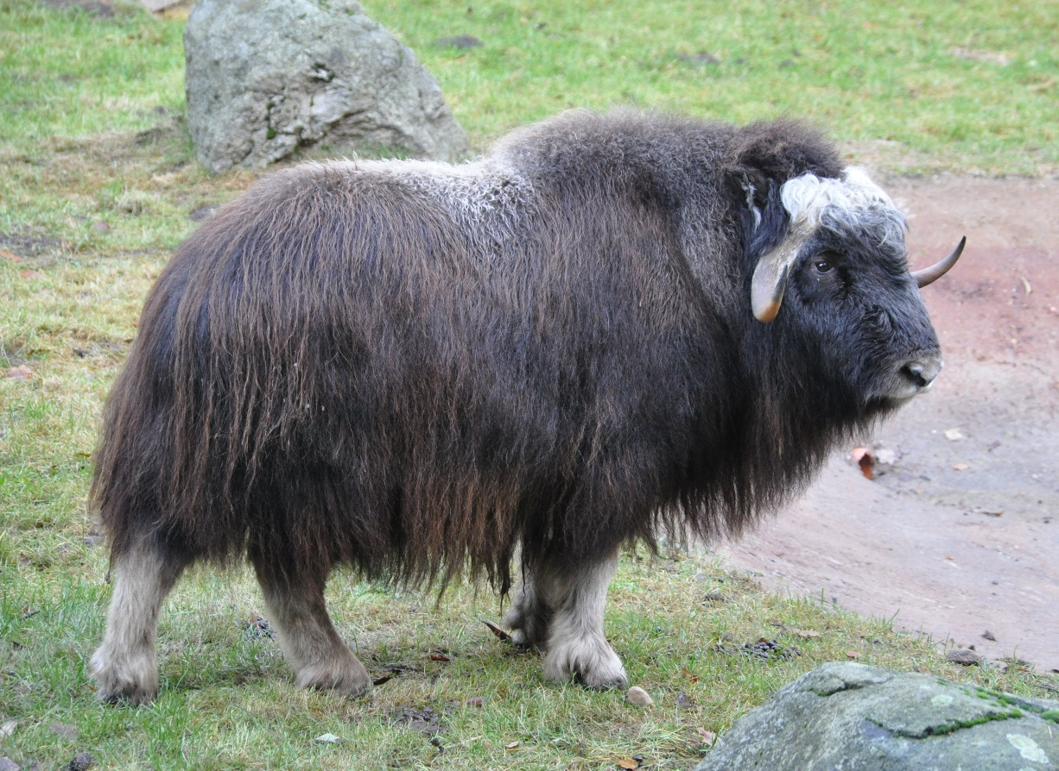
Wisdom of the crowd
Guess the weight in lbs of this ox
Crowd accuracy > expert accuracy
Notes:
traced back to an observation by Charles Darwin’s cousin Francis Galton in 1907. Galton pointed out that the average of all the entries in a ‘guess the weight of the ox’ competition at a country fair was amazingly accurate – beating not only most of the individual guesses but also those of alleged cattle experts. This is the essence of the wisdom of crowds: their average judgement converges on the right solution.

Slide 30
Wisdom of the crowd
The wisdom of the crowd is the collective opinion of a group of individuals rather than that of a single expert.
A large group's aggregated answers to questions involving quantity estimation, general world knowledge, and spatial reasoning has generally been found to be as good as, and often better than, the answer given by any of the individuals within the group.

Slide 31
Wisdom of the crowd
Failures
Herd mentality (social influences)
i.e. financial market crash
Notes:
Follow up reading: http://www.bbc.com/future/story/20140708-when-crowd-wisdom-goes-wrong

